Slide 1
Internal Demo Day: HTML/CSS
Winter 2025
DCP Hamburg

Slide 2
PORTFOLIO WEBSITE PROJECT
By Assimagbe Albert Raphael HTML & CSS Implementation

Slide 3
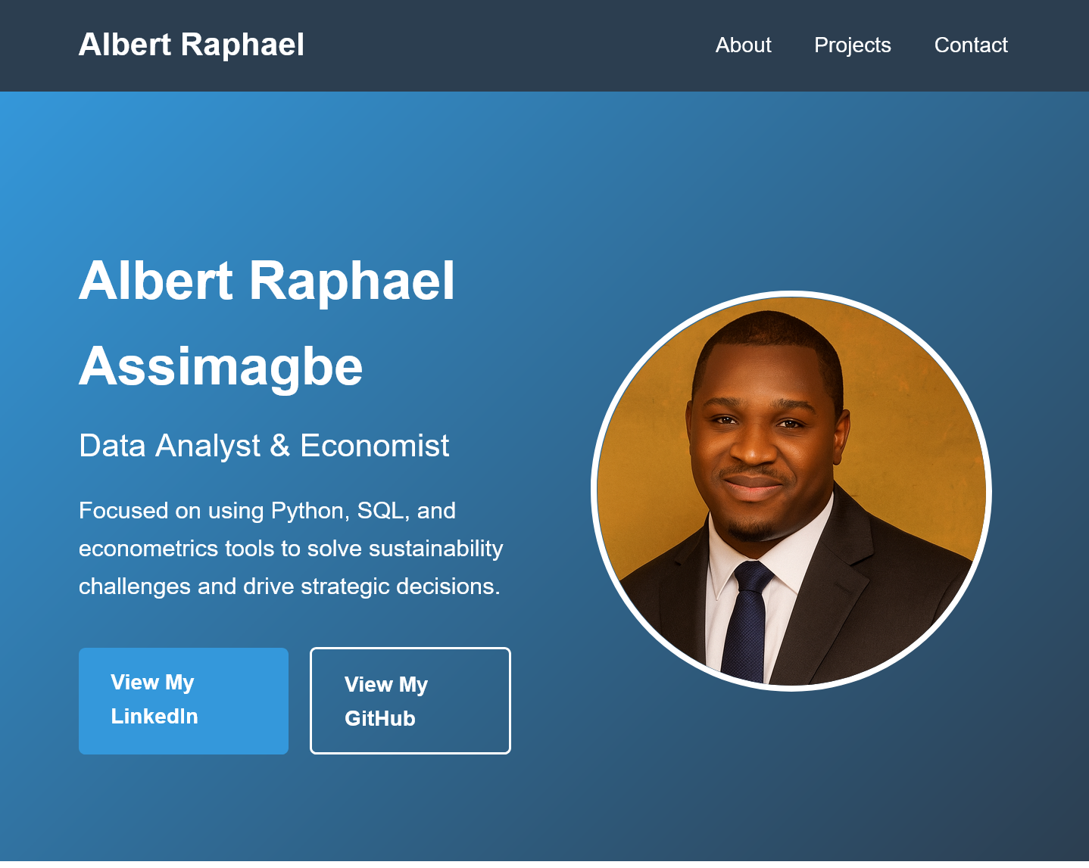
Introduction
A clean, responsive portfolio website built with pure HTML and CSS to showcase data analysis projects and professional information.
Project Objectives
Build a working website using only HTML & CSS
Create responsive design for all devices
Showcase professional portfolio
Demonstrate web development fundamentals
Provide live demo of working website
The Website Headings
Technology Stack
HTML5 - Structure and content
CSS3 - Styling and layout
Website URL: https://albert-raphael.github.io/portfolio-website/

Slide 4
HTML Structure
HTML Architecture
<!DOCTYPE html>
<html>
<head>
<title>...</title>
<meta> tags
<link> to CSS
</head>
<body>
<header>Navigation</header>
<main>
<section>Hero</section>
<section>About</section>
<section>Projects</section>
<section>Contact</section>
</main>
<footer>Copyright</footer>
</body>
</html>
Key Features
Semantic HTML5 elements
Proper document structure
Accessibility considerations
SEO-friendly mark-up

Slide 5
CSS Implementation
Layout Techniques
Flexbox - One-dimensional layouts
CSS Grid - Two-dimensional layouts
Media Queries - Responsive design
Positioning - Fixed navigation
Design Principles
Mobile-first approach
Consistent spacing
Colour hierarchy
Typography scale
Hover interactions
Responsive Breakpoints
Mobile: < 768px
Tablet: 768px - 1024px
Desktop: > 1024px

Slide 6
Project Sections Breakdown
Hero Section
Professional header
Introduction text
Call-to-action buttons
Profile image
About Section
Professional background
Skills and expertise
Technical capabilities
Projects Section
Six projects
Project images and descriptions
GitHub repository links
Contact Section
Email functionality
Social media links
Professional closing

Slide 7
Project Achievements
Technical Achievements
Pure HTML/CSS implementation
Fully responsive design
Professional visual design
Accessible and SEO-friendly
Cross-browser compatible
LEARNING OUTCOMES
HTML5 semantic structure
CSS3 layout techniques
Responsive design principles
Project organization skills
Web development workflow
Business Value
Professional online presence
Project showcase platform
Contact generation tool
Personal branding asset

Slide 8
Project Summary & Conclusion
Key Takeaways
Successfully built working website using only HTML/CSS
Implemented responsive design for all devices
Created professional portfolio showcase
Demonstrated web development fundamentals
Provided fully functional live demo
Technical Skills Demonstrated
HTML5 semantic mark-up
CSS3 styling and layout
Responsive design principles
Project planning and execution
Problem-solving and debugging

Slide 9

Thanks a lot!
Contact
Albert Raphael Assimagbe Studen tReDI School of Digital Integration NRW
albertraphael96@gmail.com

